Slide 1
COMP 3500 Introduction to Operating Systems Deadlocks
Dr. Xiao Qin
Auburn University http://www.eng.auburn.edu/~xqin
xqin@auburn.edu
Slides are adopted from Drs. Silberschatz, Galvin, and Gagne
Notes:
25 Min: Lec07c1-Project 3-6 Cats and Mice Implementation CV cont
25 Min: Lec07c2 This lecture note. Slides 1-10
No resource allocation graphs: next lecture Slides 11-18

Slide 2
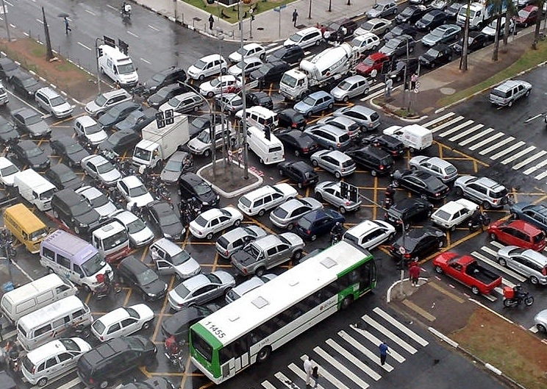
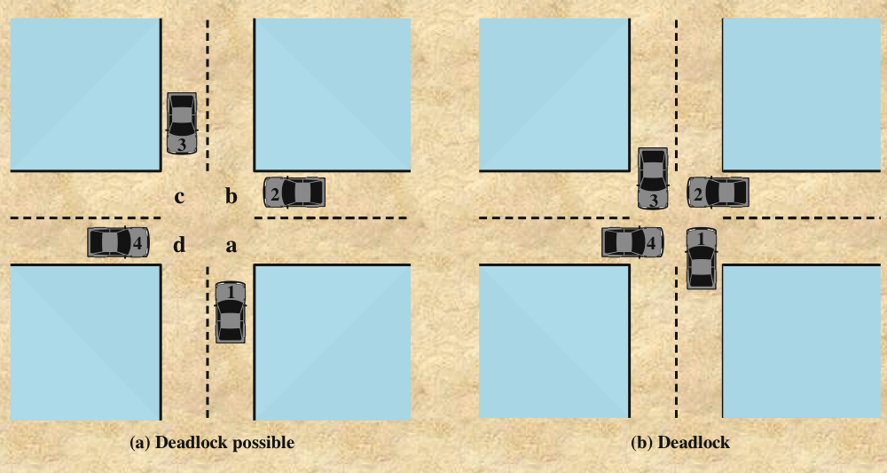
Deadlocks: A Real-Life Example
Slide courtesy of Dr. William Stallings

Slide 3
Three Deadlocked Processes
Process 1
Process 2
Process 3
Resource 1
Resource 2
Resource 3
Process holds the resource
Process requests the resource
Slide courtesy of Dr. Gary Nutt
Notes:
Three conditions of policy must be present for a deadlock to be possible:
1. Mutual exclusion . Only one process may use a resource at a time. No process may access a resource unit that has been allocated to another process.
2. Hold and wait . A process may hold allocated resources while awaiting assignment of other resources.
3. No preemption . No resource can be forcibly removed from a process holding it.
In many ways these conditions are quite desirable. For example, mutual exclusion is needed to ensure consistency of results and the integrity of a database. Similarly, preemption should not be done arbitrarily. For example, when data resources are involved, preemption must be supported by a rollback recovery mechanism, which restores a process and its resources to a suitable previous state from which the process can eventually repeat its actions.
The first three conditions are necessary but not sufficient for a deadlock to exist. For deadlock to actually take place, a fourth condition is required:
4. Circular wait . A closed chain of processes exists, such that each process holds at least one resource needed by the next process in the chain (e.g., Figure 6.5c
and Figure 6.6 ).
The fourth condition is, actually, a potential consequence of the first three. That is, given that the first three conditions exist, a sequence of events may occur that lead to an unresolvable circular wait. The unresolvable circular wait is in fact the definition of deadlock. The circular wait listed as condition 4 is unresolvable because the first three conditions hold. Thus, the four conditions, taken together, constitute necessary and sufficient conditions for deadlock.

Slide 4
Q1: Can a deadlock occur?
p 0 p 1 q 0 q 1 p 2 q 2
Slide courtesy of Dr. William Stallings
Notes:
As an example of deadlock involving reusable resources, consider two processes that compete for exclusive access to a disk file D and a tape drive T. The programs engage in the operations depicted in Figure 6.4 . Deadlock occurs if each process holds one resource and requests the other. For example, deadlock occurs if the multiprogramming system interleaves the execution of the two processes as follows:
p 0 p 1 q 0 q 1 p 2 q 2
It may appear that this is a programming error rather than a problem for the OS designer. However, we have seen that concurrent program design is challenging. Such deadlocks do occur, and the cause is often embedded in complex program logic, making detection difficult. One strategy for dealing with such a deadlock is to impose system design constraints concerning the order in which resources can be requested.

Slide 5
Q2: Can a deadlock occur?
Space is available for allocation of 200Kbytes, and the following sequence of events occur:
P1
P2
. . .
. . .
Request 80 Kbytes;
Request 70 Kbytes;
. . .
. . .
Request 60 Kbytes;
Request 80 Kbytes;
Deadlock occurs if both processes progress to their second request.
Notes:
Another example of deadlock with a reusable resource has to do with requests for main memory. Suppose the space available for allocation is 200 Kbytes, and the following sequence of requests occurs: (see diagram)
Deadlock occurs if both processes progress to their second request. If the amount of memory to be requested is not known ahead of time, it is difficult to deal with this type of deadlock by means of system design constraints. The best way to deal with this particular problem is, in effect, to eliminate the possibility by using virtual memory, which is discussed in Chapter 8 .

Slide 6

Deadlock Characterization
Deadlock can arise if four conditions hold simultaneously.
1. Mutual exclusion: only one process at a time can use a resource

Slide 7
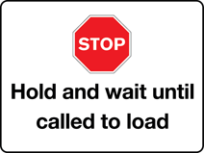
Deadlock Characterization
Deadlock can arise if four conditions hold simultaneously.
2. Hold and wait: a process holding at least one resource is waiting to acquire additional resources held by other processes

Slide 8


Deadlock Characterization
Deadlock can arise if four conditions hold simultaneously.
3.No preemption: a resource can be released only voluntarily by the process holding it, after that process has completed its task

Slide 9
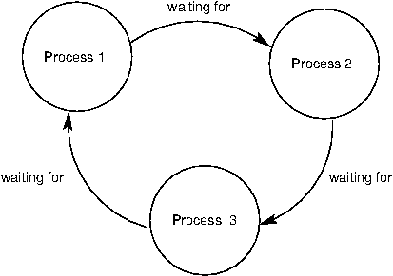
Deadlock Characterization
Deadlock can arise if four conditions hold simultaneously.
4. Circular wait:
a set {P₀, P₁, …, P_{n}} of waiting processes
P₀ is waiting for a resource that is held by P₁,
P₁ is waiting for a resource that is held by P₂, …,
P_{n–1} is waiting for a resource that is held by P_{n}, and
P_{n} is waiting for a resource that is held by P₀.

Slide 10
System Model
System consists of resources
Resource types R₁, R₂, . . ., R_{m}
CPU cycles, memory space, I/O devices
Each resource type R_{i} has W_{i} instances.
Each process utilizes a resource as follows:
request
use
release

Slide 11
Resource-Allocation Graph
A set of vertices V and a set of edges E.
V is partitioned into two types:
P = {P₁, P₂, …, P_{n}}, the set consisting of all the processes in the system
R = {R₁, R₂, …, R_{m}}, the set consisting of all resource types in the system
request edge – directed edge P_{i} → R_{j}
assignment edge – directed edge R_{j} → P_{i}

Slide 12
Resource-Allocation Graph (Cont.)
Process
Resource Type with 4 instances
P_{i} requests instance of R_{j}
P_{i} is holding an instance of R_{j}
P_{i}
R_{j}
P_{i}
R_{j}

Slide 13
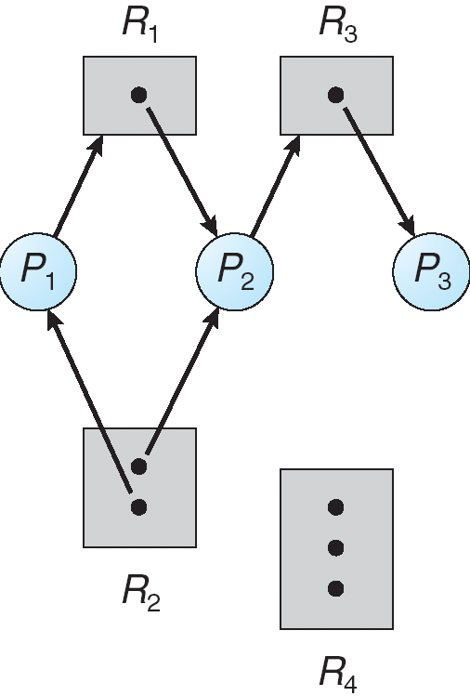
Q3: Can you explain this resource allocation graph?

Slide 14
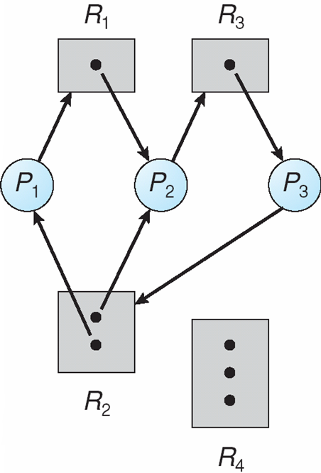
Q4: Is there any problem with this resource allocation graph?
Notes:
Answer: deadlock

Slide 15
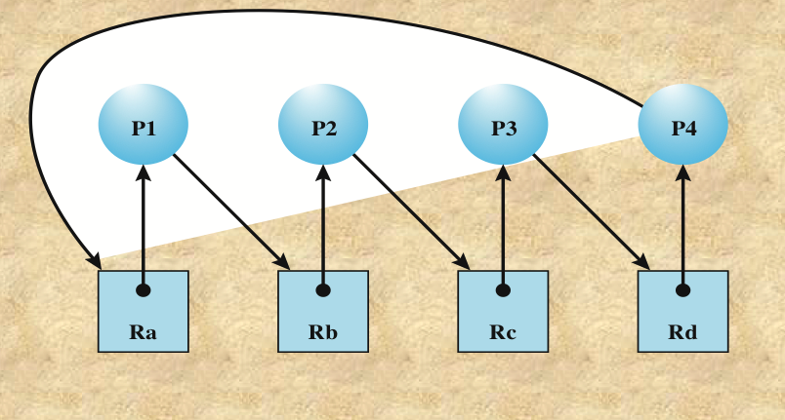
Q5: Is there any problem with this resource allocation graph?
Notes:
Answer: deadlock

Slide 16
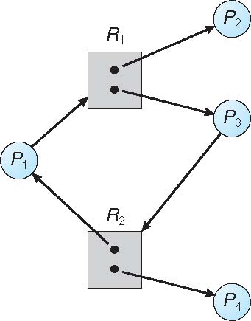
Q6: The graph below has a cycle. Is this a deadlock? Why?
Notes:
No.

Slide 17

Q7: Can you draw the following conclusions?
If graph contains no cycles ⇒ no deadlock
If graph contains a cycle ⇒
if only one instance per resource type, then deadlock
if several instances per resource type, then possibility of deadlock
Notes:
Deadlock or no deadlock?
Why no cycle then no deadlock? No circular wait (one of the four conditions)

Slide 18
Summary
Deadlock Characterization
Resource-Allocation Graph

